Slide 1

CHICAGO DOT CAR CRASHES ANALYSIS
Shayan Abdul Karim Khan
05/08/2023

Slide 2


PROBLEM OVERVIEW
1 FATAL INCIDENT EVERY 15 MINUTES
Notes:
TALK ABOUT THE BUSINESS PROBLEM
VISION ZERO
WHY IS VISION ZERO IMPORTANT

Slide 3

CDOT GOALS
37% CAUSES LABELLED AS “UNABLE TO DETERMINE”
TOP FACTORS INFLUENCING CRASHES
PREDIT CAUSES OF CRASHES
MULTI-FACTOR ANALYSIS DOES NOT EXIST
Notes:
WHAT DOES CDOT WANT TO ACCOMPLISH?
UNABLE TO DETERMINE
TOP 10 THINGS THAT CONTRIBUTE TO CRASHES

Slide 4






ANALYSIS PROCESS
CHICAGO DOT DATABASE ON CRASHES, VEHICLES AND PEOPLE
ITERATIVE DATA CLEANING & PROCESSING
MODELLING
Notes:
HOW WILL WE ACCOMPLISH THIS?
DATABASE
CLEANING/PROESSING
MODELLING
TOP 10 FEATURES AND A MODEL

Slide 5
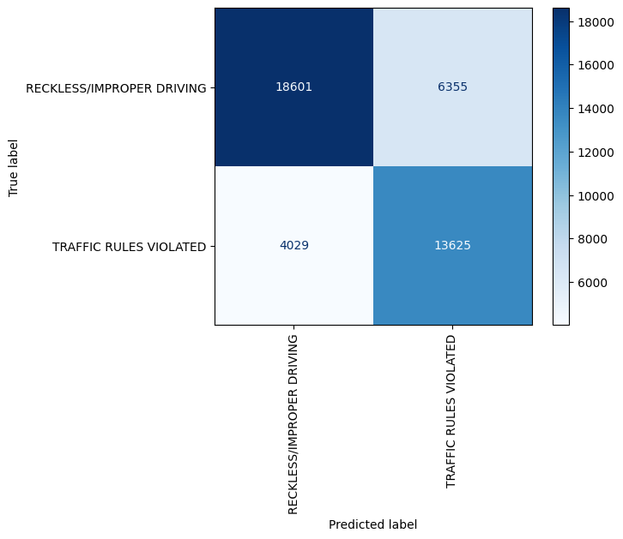
MODELLING RESULTS
4
ACCURACY: 70%
PRECISION: 70%
3
ACCURACY: 73%
PRECISION: 74%
2
ACCURACY: 74%
PRECISION: 74%
1
ACCURACY: 76%
PRECISION: 76%
RANDOM FOREST MODEL CONFUSION MATRIX
Notes:
BEST PERFORMING MODEL RESULTS
DECISION TREE
KNN
RANDOM FORESTS
XGBOOST [BEST MODEL]
UNABLE TO DETERMINE DATASET RESULTS

Slide 6





TOP FACTORS RESULTS
LATITUDE
DRIVER ACTION
LONGITUDE
MANEUVER
INTERSECTION
OCCUPANT CATEGORY
FIRST CONTACT POINT
# UNITS
WEATHER CONDITION
DEVICE CONDITION
Notes:
LOCATION BASED:
Latitude, longitude, Intersection
Driver Based:
Driver_Action, Physicial Condition, Maneuver
Traffic based:
First Contact Point, Num of units, Device Condition
Nature based:
Weather Condition

Slide 7
IMPROVEMENTS
Higher Granularity
Increased Model Iterations
Improve Sampling Methods and fill in gaps in original data
Use missing factors such as Traffic Volume and Congestion Percentages
Notes:
RECOMMENDATIONS
IMPROVEMENTS
NEXT STEPS

Slide 8
NEXT STEPS - INSIGHTS
Research the trends tied with location factors
Explore how driver actions impact crashes
Develop mobility engineering plans and awareness campaigns
Improve performance of model
Notes:
RECOMMENDATIONS
IMPROVEMENTS
NEXT STEPS

Slide 9
QUESTIONS?
Notes:
DATA SOURCE
WENT THROUGH CLEANING
4 DIFFERENT MODELS

Slide 10
CHICAGO DOT CAR CRASHES ANALYSIS
05/08/2023

Slide 11
BACKUP
Notes:
DATA SOURCE
WENT THROUGH CLEANING
4 DIFFERENT MODELS

Slide 12
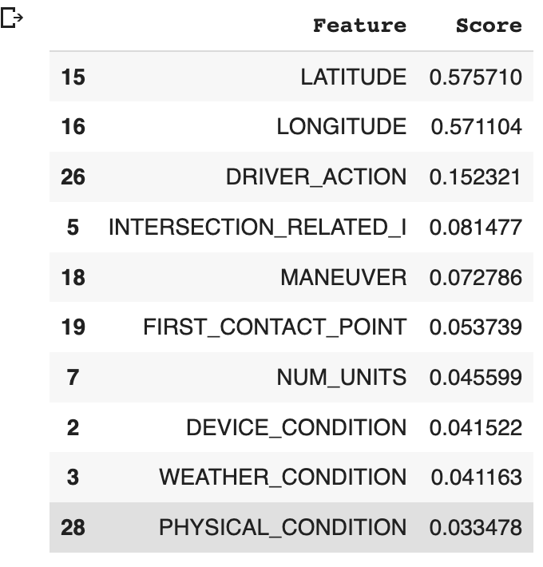
Notes:
DATA SOURCE
WENT THROUGH CLEANING
4 DIFFERENT MODELS

Slide 13
